Slide 1

Retail Banking Transaction Analysis

Slide 2


About Me
[Team Leader Name]
[Team Member 2 Name]
[Team Member 3 Name]
[B.Tech / M.Tech - Branch]
[B.Tech / M.Tech - Branch]
[B.Tech / M.Tech - Branch]
[Your career goal in one line]
[Your career goal in one line]
[Your career goal in one line]
Experience: [Fresher / years]
Experience: [Fresher / years]
Experience: [Fresher / years]

Slide 3
Table of contents
Project Overview
Business Scenario
Business Objectives
Dataset & Database Overview
ER Diagram & Database Structure
Analysis of the Objectives
Overall Key Findings
Business Recommendations
Conclusion

Slide 4
Project Overview
A retail bank provides everyday accounts, loans and cards to individual and business customers through a network of 40 branches across five regions, and records every transaction and loan repayment.
This project focuses on MySQL-based Business Analytics, leveraging data from seven core tables — Customers, Accounts, Branches, Loans, Loan Payments, Cards, and Transactions — to understand customer profiles, examine account and transaction behaviour, evaluate loan repayment, and assess card usage. The analysis aims to transform banking data into meaningful business insights that support informed decision-making and identify opportunities for improvement.

Slide 5
Business Scenario
A retail bank serves customers through a branch network, offering savings and checking accounts, loans and cards, supported by multiple transaction channels such as online, mobile, ATM and branch.
With activity spread across customers, branches and products, the bank requires better visibility into who its customers are, how accounts and channels are used, whether transactions succeed, and whether loans are being repaid. The goal is to leverage data-driven insights to manage risk, improve service quality and support business growth.

Slide 6
Business Objectives
Customer Profile & Segmentation
Understand customer segments, demographics, income, credit score, and KYC status.
Account Usage & Branch Activity
Examine account types, balances, interest rates, and branch-level activity.
Transaction Patterns
Assess transaction status, types, channels, and completed value over time.
Loan Performance & Repayment
Evaluate loan status, repayment behaviour, late payments, and penalties.
Card Usage & Product Engagement
Review card activation, expiry, utilisation, and customers holding multiple products.

Slide 7
Dataset & Database Overview
The database consists of seven tables, each representing a dataset:
Customers: 500 records across 13 columns, covering customer details, location, customer since date, KYC status, segment, annual income, credit score, and active status.
Accounts: 700 records across 10 columns, covering customer and branch links, account type, open and close dates, balance, interest rate, overdraft limit, and status.
Branches: 40 records across 7 columns, covering branch name, city, state, region, opening date, and employee count.
Loans: 300 records across 13 columns, covering customer and branch links, loan type, principal, interest rate, tenure, EMI, outstanding balance, status, and purpose.
Loan Payments: 2,000 records across 11 columns, covering loan link, payment date, scheduled and paid amounts, penalty, days late, payment method, and status.
Cards: 600 records across 10 columns, covering account link, card type, issue and expiry dates, credit limit, outstanding balance, reward points, active status, and network.
Transactions: 5,000 records across 10 columns, covering account link, date and time, type, amount, channel, description, balance after, and status.
Data Observation: The close_date field is blank for the 497 active accounts, and transaction status (Completed, Pending, Failed) is stored as text, so value analysis uses Completed transactions only.

Slide 8
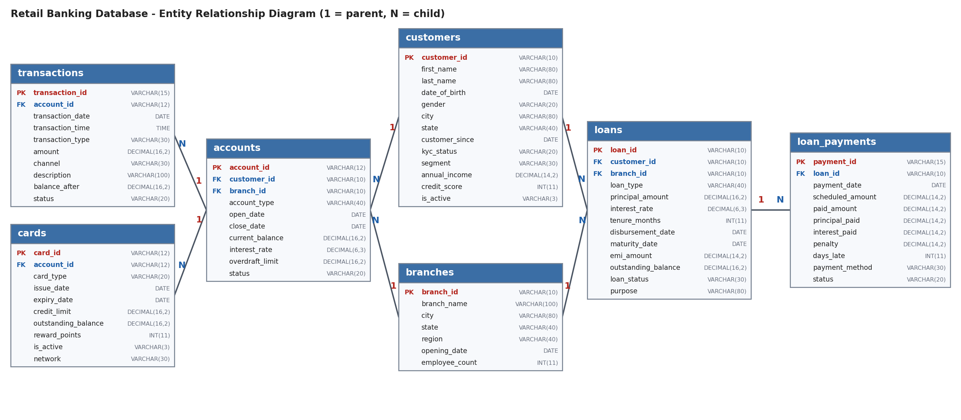
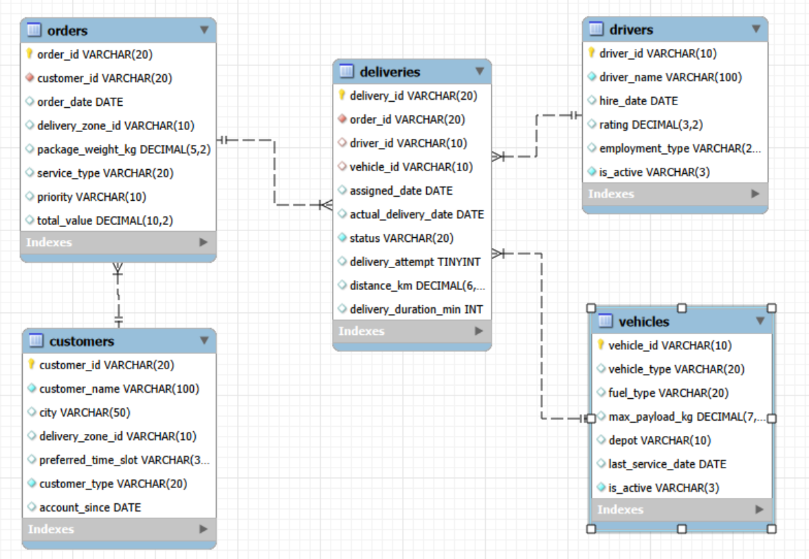
ER DIAGRAM AND DATABASE STRUCTURE

Slide 9
ER DIAGRAM AND DATABASE STRUCTURE
The database contains seven tables: Customers, Accounts, Branches, Loans, Loan Payments, Cards, and Transactions.
Primary Keys: Identifies each record uniquely in the table.
Foreign Keys: Maintain the relationship between tables.
Table Name | Primary Key | Foreign Keys
Customers | customer_id | None
Accounts | account_id | customer_id, branch_id
Branches | branch_id | None
Loans | loan_id | customer_id, branch_id
Loan Payments | payment_id | loan_id
Cards | card_id | account_id
Transactions | transaction_id | account_id

Slide 10
ER DIAGRAM AND DATABASE STRUCTURE
TABLE RELATIONSHIPS
Customers – Accounts (1:M): A customer can hold multiple accounts, while each account belongs to one customer.
Branches – Accounts (1:M): A branch manages many accounts, while each account is opened at one branch.
Customers – Loans (1:M): A customer can take multiple loans, while each loan belongs to one customer.
Branches – Loans (1:M): A branch originates many loans, while each loan is linked to one branch.
Accounts – Transactions (1:M): An account can have many transactions, while each transaction belongs to one account.
Accounts – Cards (1:M): An account can have multiple cards, while each card is linked to one account.
Loans – Loan Payments (1:M): A loan has many scheduled payments, while each payment belongs to one loan.
Customers – Branches (M:N): Customers and branches are connected through the Accounts and Loans tables.

Slide 11
Analysis of Objectives
Objective 1: Customer Profile & Segmentation
Customers by Segment (A1)
  Student is the largest segment: 100 customers (20.00%); Business follows with 97 (19.40%)
  Senior is the smallest: 73 customers (14.60%), so the six segments are fairly evenly spread
Gender and Financial Profile (A2, A3)
  Male: 190, Non-binary: 156 and Female: 154 customers
  Premium has the highest average annual income ($158,667.68); Retail has the lowest ($140,525.70)
  Average credit score is similar across segments, from 679.2 (Student) to 687.1 (Retail)

Slide 12
Analysis of Objectives
KYC and Active Status (A4)
  Verified: 143 customers (134 active); Partial: 129 (123 active); Pending: 123 (118 active)
  Failed KYC: 105 customers, all of them inactive
  375 of 500 customers (75%) are active
Customer Tenure (A5)
  Student and Business customers have the longest average tenure (7.67 years); Premium the shortest (6.70 years)
Customers with Multiple Accounts (A6)
  211 customers hold more than one account; Anna Jones (C000226) holds the most (8)
  134 customers have no account

Slide 13
Analysis of Objectives
Objective 2: Account Usage & Branch Activity
Accounts by Type and Status (B1)
  700 accounts: 497 Active and 203 Closed; closed accounts carry a zero balance
  IRA has the most active accounts (103) and the highest total balance ($2,894,008.04)
  Certificate of Deposit has the highest average balance ($32,945.34); Checking the lowest ($5,517.35)
Interest Rate by Account Type (B3)
  Certificate of Deposit has the highest average rate (4.617%); Checking the lowest (0.245%)
Account Usage on Completed Transactions (B4)
  IRA leads: 350 completed transactions worth $2,489,743.81; Certificate of Deposit follows ($2,081,309.27)
  Checking is lowest in value ($1,260,676.09 from 245 transactions)

Slide 14
Analysis of Objectives
Branch Activity (B2)
  Atlanta Branch (BR025) holds the highest total balance ($501,926.47) across 18 accounts
  Pittsburgh Branch (BR011) has the most accounts (28), followed by San Diego Branch (27)
Accounts by Region
  South has the most accounts (242), then East (169) and West (168); North has the fewest (34)
Branch Loan Exposure (B5)
  Austin Branch (BR032) has the highest outstanding loan balance ($2,893,214.67) across 14 loans
  Jacksonville Branch (BR001) is second ($2,623,874.87), followed by Omaha Branch (BR017) ($2,437,785.88)

Slide 15
Analysis of Objectives
Objective 3: Transaction Patterns
Transaction Status (C1)
  Of 5,000 transactions: Completed 1,688 (33.76%), Pending 1,684 (33.68%), Failed 1,628 (32.56%)
  Only Completed transactions count towards value: $10,976,552.36 in total
Type and Channel Mix (C2)
  ATM Withdrawal through ATM is the largest combination: 271 transactions, $1,549,386.01
  Interest credits via Online ($1,192,243.30) and Branch ($997,230.87) follow
  By channel: Online is highest ($3,455,257.94); Wire Transfer is lowest ($439,546.06)
  By type: Credit is highest ($2,338,007.84); Fee is lowest ($1,486,437.43)

Slide 16
Analysis of Objectives
Monthly Completed Transaction Trend (C3)
  Completed value rose every year: $2,920,690.19 (2022), $3,807,624.68 (2023), $4,073,991.96 (2024)
  Completed transactions grew from 431 (2022) to 577 (2023) and 656 (2024)
  Only 24 completed transactions fall before 2022, so the trend rests mainly on 2022–2024
Transaction Descriptions (C4)
  Investment is the top purpose: 485 transactions, $3,699,812.36; Utility (432) and Rent (307) follow
  Transfer is lowest in value ($525,008.36)
Largest Transactions and Segments (C5, C6)
  Largest completed transaction: $14,987.16 (TXN00002295, Credit via Branch)
  Business customers have the highest completed value ($2,420,559.91); Premium the lowest ($1,422,631.94)

Slide 17
Analysis of Objectives
Objective 4: Loan Performance & Repayment
Loan Portfolio by Status (D1)
  300 loans with $53,441,891.25 outstanding in total
  In Arrears: 83 loans ($20,569,787.74); Defaulted: 86 loans ($18,595,217.92)
  Active: 65 loans ($14,276,885.59); Closed: 66 loans (no outstanding balance)
  169 loans (56.3%) are In Arrears or Defaulted
Loan Type Performance (D2)
  Education has the highest outstanding balance ($10,937,737.62) and the highest average rate (11.65%)
  Personal has the lowest outstanding balance ($7,676,485.94); Auto has the lowest average rate (10.06%)

Slide 18
Analysis of Objectives
Payment Status and Penalties (D3)
  Of 2,000 payments: Paid 573, Late 500, Missed 468 and Pending 459
  Late or Missed payments total 968 (48.4%)
  Late payments average 22.52 days late and carry $93,961.47 in penalties
Repeated Late or Missed Payments (D4)
  255 loans have two or more late or missed payments; the worst have 8 (L000236, L000131, L000062)
Repayment by Branch and Payment Method (D5, D6)
  Los Angeles Branch has the highest late or missed rate (69.70%), followed by Washington Branch (68.75%)
  Cheque is the most used payment method (388 payments); Cash has the longest average delay (6.52 days)

Slide 19
Analysis of Objectives
Objective 5: Card Usage & Product Engagement
Card Type and Active Status (E1)
  600 cards: 242 Credit and 358 Debit; only 37 are active (15 Credit, 22 Debit)
  Credit cards carry $2,457,114.58 outstanding, of which $2,305,603.38 sits on inactive cards
Expired Cards (E2)
  445 cards had expired by 22 Feb 2025, the latest transaction date
Card Utilisation (E5)
  Credit cards average 39.70% utilisation of their limit; utilisation does not apply to Debit cards

Slide 20
Analysis of Objectives
Card Network Mix (E4)
  Debit: Visa 96, Mastercard 94, American Express 93, Discover 75
  Credit: Discover 65 ($691,961.94 outstanding), Visa 63, Mastercard 59 and American Express 55
  American Express credit cards carry the second-highest balance ($645,180.05) despite being the fewest
Customers with Multiple Product Categories (E3)
  316 of 500 customers (63.2%) hold at least two of the three categories: accounts, cards, loans
  124 customers hold all three categories; 192 hold two
  C000345, C000325 and C000237 are among the customers holding all three

Slide 21
Overall Key Findings
Customer and Account Insights
  Six segments are evenly spread (14.6%–20.0%); Student (100) and Business (97) are the largest
  Only 143 of 500 customers (28.6%) are KYC Verified; all 105 with Failed KYC are inactive
  211 customers hold multiple accounts, while 134 customers hold none
  497 of 700 accounts are active; closed accounts hold zero balance
  Certificate of Deposit and IRA carry the highest balances and interest rates
  South has the most accounts (242); North has the fewest (34)

Slide 22
Overall Key Findings
Transaction Outcomes
  Only 33.76% of 5,000 transactions are Completed; 33.68% are Pending and 32.56% Failed
  Completed value is $10,976,552.36; Online is the leading channel ($3,455,257.94)
  Completed value grew each year, from $2,920,690.19 (2022) to $4,073,991.96 (2024)
Spending Behaviour
  Investment, Utility and Rent are the top transaction purposes by value
  Business customers generate the highest completed value ($2,420,559.91)
Data Note
  Only 24 completed transactions fall before 2022, so the analysis rests mainly on 2022–2024

Slide 23
Overall Key Findings
Loan Risk
  169 of 300 loans (56.3%) are In Arrears or Defaulted: $39,165,005.66 of $53,441,891.25 outstanding
  968 of 2,000 payments (48.4%) are Late or Missed; Late payments carry $93,961.47 in penalties
  255 loans have two or more late or missed payments
Cards and Product Engagement
  Only 37 of 600 cards (6.2%) are active, and 445 cards have expired
  Credit cards average 39.70% utilisation of their limit
  316 customers (63.2%) hold two or more product categories

Slide 24
Business Recommendations
Improve Transaction Reliability
  Investigate Pending and Failed transactions (C1) by channel and type, and set a time limit for pending items
  Save the C1 and C2 queries as views for regular monitoring
Strengthen Loan Collections
  Use the D4 list (255 loans with repeated late or missed payments) as the collections worklist, starting with the 169 In Arrears or Defaulted loans
  Review branches with the highest late or missed rates: Los Angeles (69.70%) and Washington (68.75%)
  Send early reminders, as Late payments average 22.52 days late
Complete Customer KYC
  Follow up on 129 Partial and 123 Pending customers, and re-verify the 105 with Failed KYC

Slide 25
Business Recommendations
Reconcile Card Data
  Review the 445 expired cards and confirm how the is_active flag is defined
  Review inactive credit cards that carry $2,305,603.38 in outstanding balance
Grow Deposits and Cross-Sell
  Promote higher-balance products (Certificate of Deposit, IRA) and cross-sell to the 184 customers holding fewer than two product categories
  Reach out to the 134 customers who have no account
Strengthen Monitoring
  Add data-quality checks (row counts, duplicates, missing parents) after each data load
  Run recurring KPI queries: completed value, loan risk, active cards and KYC Verified
  Document status definitions with business owners

Slide 26
Conclusions
The bank has a balanced customer base but weak operational and risk indicators
Only 33.76% of transactions are Completed, although completed value grew from $2.92M (2022) to $4.07M (2024)
56.3% of loans are In Arrears or Defaulted, and 48.4% of loan payments are Late or Missed
Only 28.6% of customers are KYC Verified, and only 6.2% of cards are active
63% of customers hold two or more product categories, creating a base for cross-selling
Targeted action on transaction processing, loan collections and data quality will matter more than adding new products
Data note: this is a case-study dataset, and only 24 completed transactions fall before 2022, so conclusions rest mainly on 2022–2024.

Slide 27

THANK YOU

